Slide 1
2023 NATIONAL YOUTH RISK BEHAVIOR SURVEY Co-Occurring Adverse Experiences & Protective Factors in Adolescent Suicidality
A survey-weighted analysis of self-reported adversity, protective behaviours, and suicide-risk outcomes among U.S. high school students
Jacinta · Aliya · Destiny · Albert · Terence · Francis · Bernard

Slide 2
Table of contents
01
Background
04
Recommendations
An introduction to our project, key aims and objectives
A closer look at our dataset refinements and further analysis
02
Methodology
05
Conclusion
An overview of our approach to the data source, and methods of collaborative working (GitHub, Teams, Google Drive)
A summary of our conclusions, limitations, and next steps
03
Key findings
05
Q&A
A breakdown of key results across the four suicide outcomes
An opportunity to further explore our project and address your questions

Slide 3
01
Introduction
An introduction to our project, key aims and objectives

Slide 4
Background
2021
2022
2023
2026
Emergency
Hearing
Evidence
Investigation
American Academy of
Child and Adolescent
Psychiatry declared a
"national emergency in
child and adolescent mental health" in the U.S.
The U.S. Senate HELP Committee held a
formal hearing,
“Why Are So Many American Youth in a Mental Health Crisis?"
CDC’s national survey quantifies the scale of the crisis among U.S. high schoolers
Our project examines which adverse and protective experiences
co-occur with this risk

Slide 5
Background
Suicide is the second leading cause of death among Americans aged 10-34
Over the past decade, rates of serious suicidal ideation have rise

Slide 6
Background
1 in 5
39.7%
9.5%
seriously considered attempting suicide in the past 12 months
of students reported persistent sadness or hopelessness
in the past 12 months
attempted suicide one or more times
in the past 12 months

Slide 7
Background
Suicide risk rarely comes from one thing. This gap motivates our research question:
how do adverse and protective experiences co-occur with adolescent suicidality, and what does that mean for where prevention efforts should focus?

Slide 8
02
Methodology
An overview of our approach
to the data source, and
methods of collaborative

Slide 9
Study design: 2023 National YRBS
What is it?
Why does this design matter?
A nationally representative, biennial CDC survey of U.S. high school students (grades 9-12)
Anonymous, self-report questionnaire: every value in this dataset is what a student said, not something independently verified
20,103 usable student responses in the 2023 cycle
Three-stage stratified cluster design:
strata → primary sampling units (PSUs, roughly clusters of schools) → classrooms
Weight
Each respondent stands in for a number of real students nationally (not every student in the survey represents just one person)
stratum / psu
Students in the same school answer more alike than random students elsewhere.
Ignoring this understates uncertainty.

Slide 10
Project structure
 | Domain | Details | Variables
Jacinta | Demographics |  | Q1, Q2, Q3, raceeth
Aliya | Protective factors |  | QN85, QN87, QN99, QN103, QN104
Destiny | Adverse factors | Sexual dating and violence | QN19, QN20, QN21, QN88
Albert | Adverse factors | School and community | QN22, QN23, QN24, QN25, QN86
Terence | Adverse factors | Household dysfunction | QN89, QN90, QN91, QN100, QN101, QN102
Francis | Risk behaviours | Violence and mental distress | QN12, QN13, QN16, QN26, QN84
Bernard | Risk behaviours | Substance use | QN43, QN48, qntb4, qnillict, qnowt, qnobese

Slide 11
Study design: How we analysed it
Accounting for clustering
Independent validation
Design-based estimation
YRBS surveys students in clusters by school, not individually at random.
So, treating each row as independent understates true uncertainty in our own comparisons.
Every prevalence estimate uses design-based estimation
(Taylor series linearisation), incorporating stratum, PSU, and survey weight.
The same method the CDC uses in its own official YRBS analyses.
Before trusting our own results, we independently reproduced CDC’s published national figures from the raw data, and matched them.

Slide 12
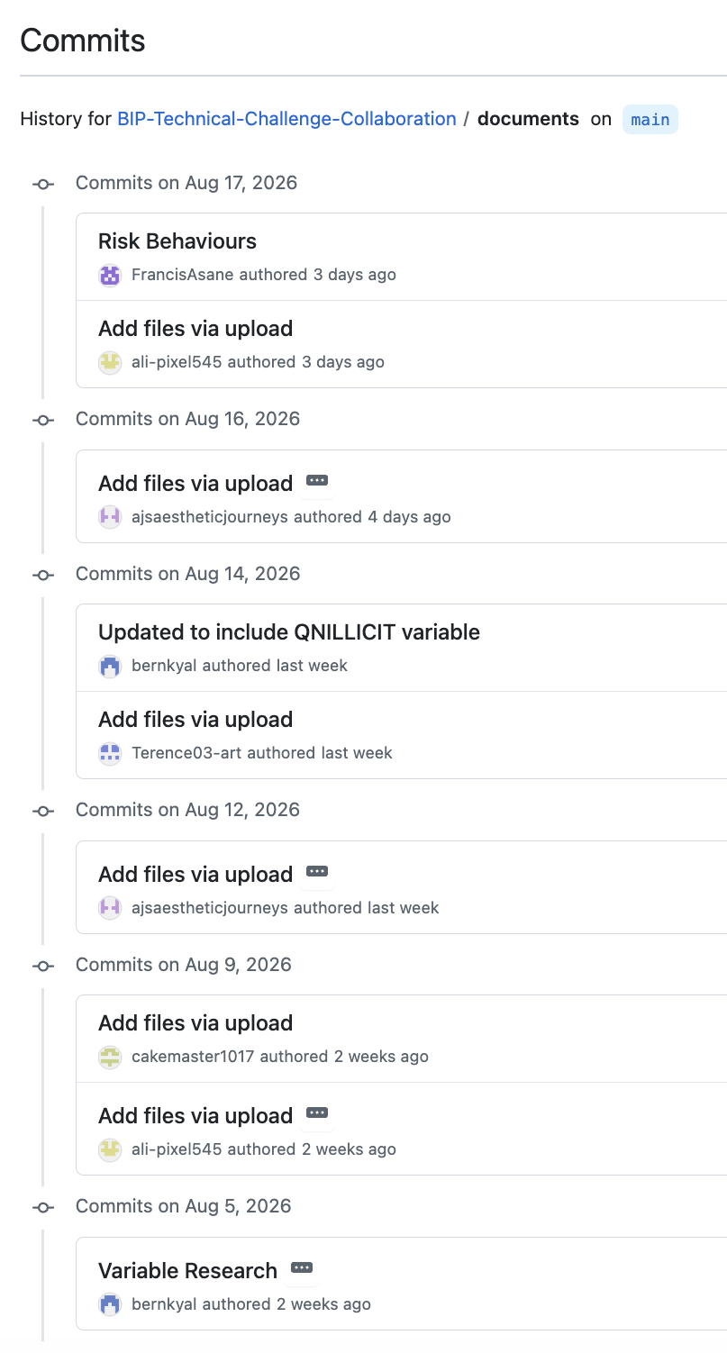
Reproducibility via GitHub
Everything lives in one place
All scripts, data, documentation, and outputs are tracked in a single public repository to see the full history of the project
Every change is logged and attributed
21 commits across the project, each with a description of what changed and who changed it (from variable selection to charts)
Structured for reproducibility
Separate folders for data, scripts, output, markdown, and documents the pipeline from raw data to final figures is traceable end to end.
Analysis can be re-run from scratch
Anyone can rebuild our results because the R scripts and outputs are version-controlled together

Slide 13
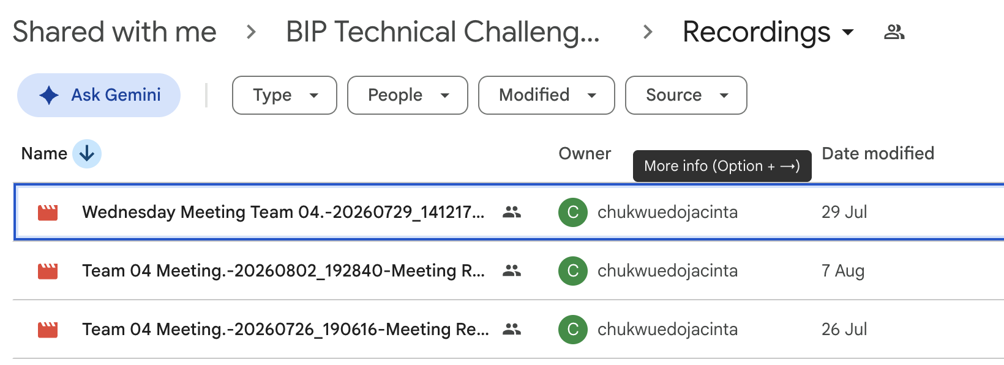
Collaboration via Google Drive & Teams

Slide 14
03
Key findings
A breakdown of key results across the four suicide outcomes

Slide 15
Destiny’s variables
2.8x
Variable | Measures | Missing
QN19 | Ever physically forced to have sexual intercourse | 13.9%
QN20 | Forced to do sexual things, past 12 months | 21.6%
QN21 | Sexual dating violence (among students who dated) | 33.1%
QN88 | Sexual contact from someone 5+ years older | 31.2%
higher lifetime suicide risk among sexual violence survivors vs. non-survivors (Mondin et al., Brazil, n=1,560)
27.3% vs 9.4%
suicidality prevalence in sexually assaulted vs. unassaulted subsamples (Dworkin et al., meta-analysis)
Na et al.’s review of meta-analyses names childhood sexual assault among the strongest identified risk factors for suicide attempt.
All classified as adverse experiences, for sexual dating and violence

Slide 16
Terence’s variables
Variable | Description | Missing
QN89 / QN90 | Verbal or physical abuse by a household adult | OR 1.5-3x (verbal); 2-3x (physical) higher odds of suicidal ideation/attempts (Liu et al. 2017; Miller et al. 2013; Norman et al. 2012)
QN91 | Domestic violence witnessed in the home | Substantially increased Lifetime suicide-attempt risk (Felitti et al. 1998, original ACE Study; Hughes et al. 2017)
QN100 | Parental/guardian substance use problem | 2-3x increase in odds of lifetime suicide attempt (Felitti et al. 1998); effect persists after controlling for sociodemographics (Hughes et al. 2017)
QN101 | Parental/guardian mental illness or suicidality | Roughly doubled odds of lifetime attempt (Felitti et al. 1998); one of the strongest household-level predictors in prior YRBS cycles (Baiden et al. 2021)
QN102 | Separation from a parent due to incarceration | Significantly elevated mental health problems, including suicidal thoughts and self-harm (Murray et al. 2012)
All classified as adverse experiences, for household dysfunction

Slide 17
Aliya’s variables
HOLDS ACROSS
ALL 20 COMPARISONS
Every 1 of the 5 protective factors showed lower prevalence on every one of the 4 suicidality outcomes:
Considered
Planned
Attempted
Injured
Protective factors

Slide 18
Aliya’s variables (protective factors)
Factor | CDC adjusted PR (2023 YRBS) | Our ratio (unadjusted) | Agreement
Sleep (QN85) | 0.53 - 0.67 | 0.48 - 0.49 | Close match
Basic needs met (QN99) | 0.41 - 0.80 | 0.23 - 0.66 | Close match
Parental monitoring (QN104) | 0.51 - 0.74 | 0.34 - 0.66 | Close match
School connectedness (QN103) | 0.63 - 0.70 | 0.52 - 0.56 | Close match
Grades (QN87) | Not tested by CDC | 0.34 - 0.66 | Consistent with outside literature
A ratio below 1.0 = lower risk in the protective-factor group. 0.53 ≈ roughly half the risk.
Sleep, basic needs, parental monitoring and school connectedness are the exact protective factors CDC selected for its own 2023 YRBS analysis: and our unadjusted ratios sit close to their adjusted ones.
Grades isn’t one of CDC’s six protective factors, so we drew on outside literature instead — directionally consistent, but the least consistently supported of the five across subgroups in the wider research.
Protective factors

Slide 19
Francis’ variables
Variable | Question | Findings
QN12 | Carried a weapon (gun, knife, or club) on school property, past 30 days | Onoh et al. (2008): weapon carrying independently associated with suicidal ideation (OR=1.64), depression (OR=1.44), and physical fighting (OR=2.02)
QN13 | Carried a gun, past 12 months (excluding hunting/sport) | Kagawa et al. (2019): 2.4% prevalence (vs. 3.5% here); 65% of gun carriers met criteria for a psychiatric disorder; linked to conduct disorder (APR=1.88), drug use disorder (APR=1.91), specific phobias (APR=1.54). Baiden et al. (2024): significantly associated with sad/hopeless (OR=1.61)
QN16 | Number of physical fights, past 12 months | Macková et al. (2021): family-related adversity significantly predicted more fighting (p<.001), mediated by hopelessness (indirect effect ab=0.04, 95% CI: 0.02–0.05) — a plausible mechanism linking sadness/hopelessness to fighting
QN26 | Felt sad or hopeless almost every day for 2+ weeks, past 12 months | Baiden et al. (2024): significant bivariate association with gun carrying (OR=1.61, p<.001), not significant after full adjustment (AOR=0.77, p=.188)
QN84 | Self-rated poor mental health, past 30 days | Baiden et al. (2024): significant bivariate association with gun carrying (OR=1.32, p=.027), not significant after full adjustment (AOR=0.99, p=.961)

Slide 20
Bernard’s variables
Variable | Question | Findings
QN43 | Had 4+ (female) or 5+ (male) drinks in a row, at least 1 day in the past 30 days | Onoh et al. (2008): weapon carrying independently associated with suicidal ideation (OR=1.64), depression (OR=1.44), and physical fighting (OR=2.02)
QN48 | Used marijuana, past 30 days | Evidence on marijuana's link to suicidal ideation is mixed: some studies report a 50-65% increase in risk during adolescence, while others find significance only among heavy users.
QNTB4 | Number of physical fights, past 12 months | A 28-country adolescent study found a positive direct relationship between cigarette smoking and suicide attempts via moderated mediation analysis, motivating a check of whether this pattern holds in YRBS data.
QNILLICIT | Used cocaine, inhalants, heroin, methamphetamines, ecstasy, or hallucinogens 1+ times, lifetime | Tunagur's research highlights a correlation between high suicide risk and frequent drug use. Because this variable captures only whether use occurred (not frequency), it's unclear whether that pattern will hold here
QNOWT, QNOBESE | Self-rated poor mental health, past 30 days | In adults, overweight/obesity has been linked to suicidal ideation, particularly in female professionals under 35. Young adults specifically, studies show a strong correlation with suicidal ideation, particularly among young men

Slide 21
Albert’s variables
QN22 (physical dating violence) has a weighted prevalence of 10.4%. Baiden, Mengo and Small (2019), using 2015 national YRBS data, found students with a history of physical teen dating violence were 1.92x more likely to report suicidal ideation, 1.67x more likely to have made a plan, and 2.42x more likely to have attempted suicide than peers without this history.
QN23 (racial/ethnic discrimination in school) captures a distinct adversity dimension rooted in identity-based discrimination rather than interpersonal violence. Baiden and colleagues (2022) found perceived racial discrimination in school was significantly associated with suicidal ideation, planning, and attempts among racial and ethnic minority adolescents.
QN24 and QN25 (school bullying and electronic bullying) analysed by Messias, Kindrick and Castro (2014) found bullying victimisation — school, electronic, or both — strongly associated with sadness and suicidality, with the highest odds among students experiencing both forms. A meta-analysis by Holt and colleagues (2015) confirmed bullying involvement is consistently associated with suicidal ideation and attempts across dozens of studies.
interchangeable ones
QN86 (unstable housing) is unlike the other four variables in this group in that it reflects a structural/socioeconomic circumstance rather than an interpersonal event. Added to the national YRBS for the first time in 2021, CDC's own analysis (McKinnon et al., 2023) found that although only 2.7% of US high school students experienced unstable housing nationally, these students reported substantially higher rates of suicidal ideation and attempts than stably housed peers.

Slide 22
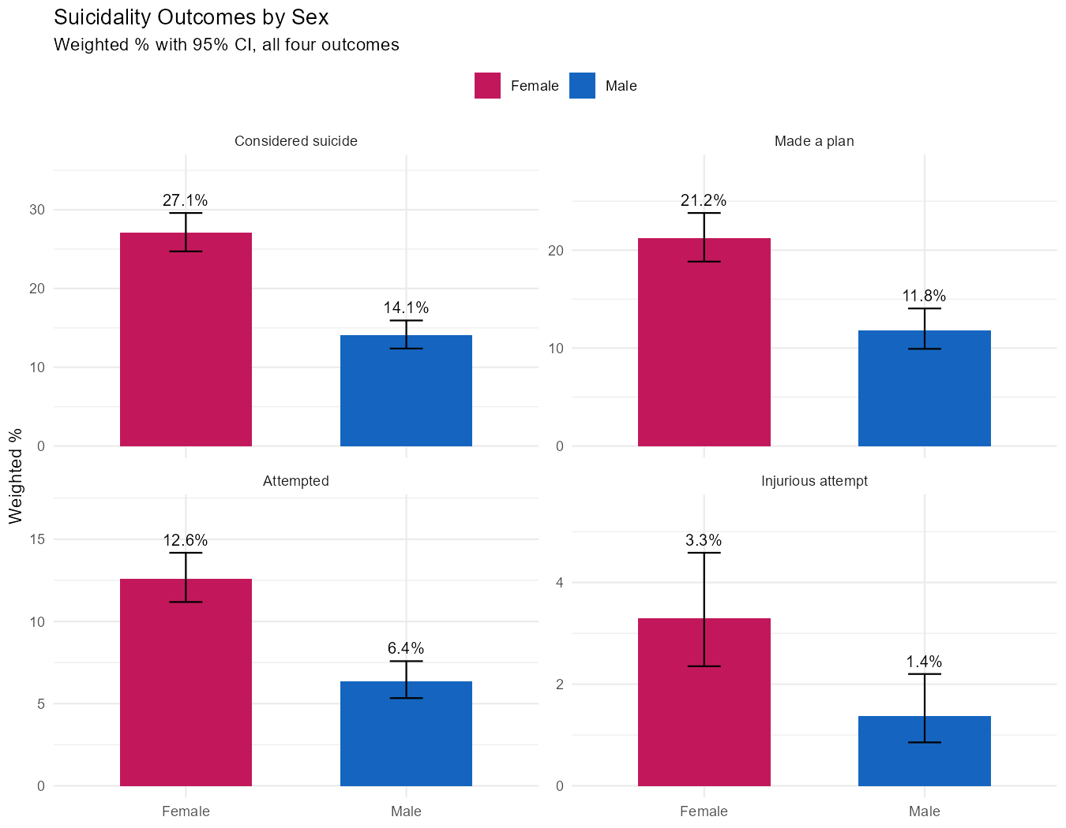
Jacinta’s variables
Overall
Sex shows the strongest and most consistent demographic pattern in this dataset.
Female students report significantly higher prevalence than male students across all four outcomes
Composition
White 48.1%
Multi-Hispanic/Latino 19.8%
Black 13.3%
Hispanic 7.7%
Multi-non-Hispanic
6.1%
Asian 4.3%
Key findings
Race/ethnicity's relationship with suicidality is inconsistent across the four outcomes — statistically significant for considered suicide (p=0.003) and attempted suicide (p=0.008), but not significant for made a plan (p=0.100) or injurious attempt (p=0.082).

Slide 23
04
Recommendations
A closer look at our dataset refinements and further analysis

Slide 24
Limitations
Direction and causality
This is cross-sectional, self-report data. We can't establish that a protective factor came before (or caused a change in) an outcome, only that they co-occur
Recall & reference periods
Different questions ask about “during your life,” “past 12 months,” and “past 30 days”.
These inconsistent windows can affect recall and comparability
Overlapping factors
Protective factors are interrelated (i.e., a well-monitored student may also sleep more), so this analysis can't isolate each factor's independent contribution
Unmeasured cofounders
Household socioeconomic status is known to shape both protective factors and mental health outcomes, however isn’t captured in the YRBS

Slide 25
05
Conclusions
A summary of our conclusions, limitations, and next steps

Slide 26
Two sides of the same picture
Adverse experiences
Protective factors
Sexual & dating violence,
household dysfunction, school & community adversity, violence-adjacent behaviours each individually linked to higher suicide-risk indicators in prior research
↑ higher prevalence
Sleep, grades, basic needs met, school connectedness, parental monitoring, each associated with substantially lower prevalence of every suicidality outcome measured.
↓ lower prevalence

Slide 27
Thanks!
Does anyone have any questions?
Please keep this slide for attribution

